Slide 1
PRACTICAL #3
Change in carbonate biogeochemistry across the globe: a visualisation analysis based on GLODAP versions 1 & 2
AIMS
Apply theoretical knowledge of the carbon cycle within the context of climate change using climatological-derived products
Understand the concept of column inventory
Acknowledge the limitation(s) of climatological-derived products
Practice data analysis with Python
Ocean CO₂: Theory and Observations
UCT, SOCCO-CSIR
21.05.2019
pmonteir@csir.co.za; alice.Lebehot@uct.ac.za

Slide 2
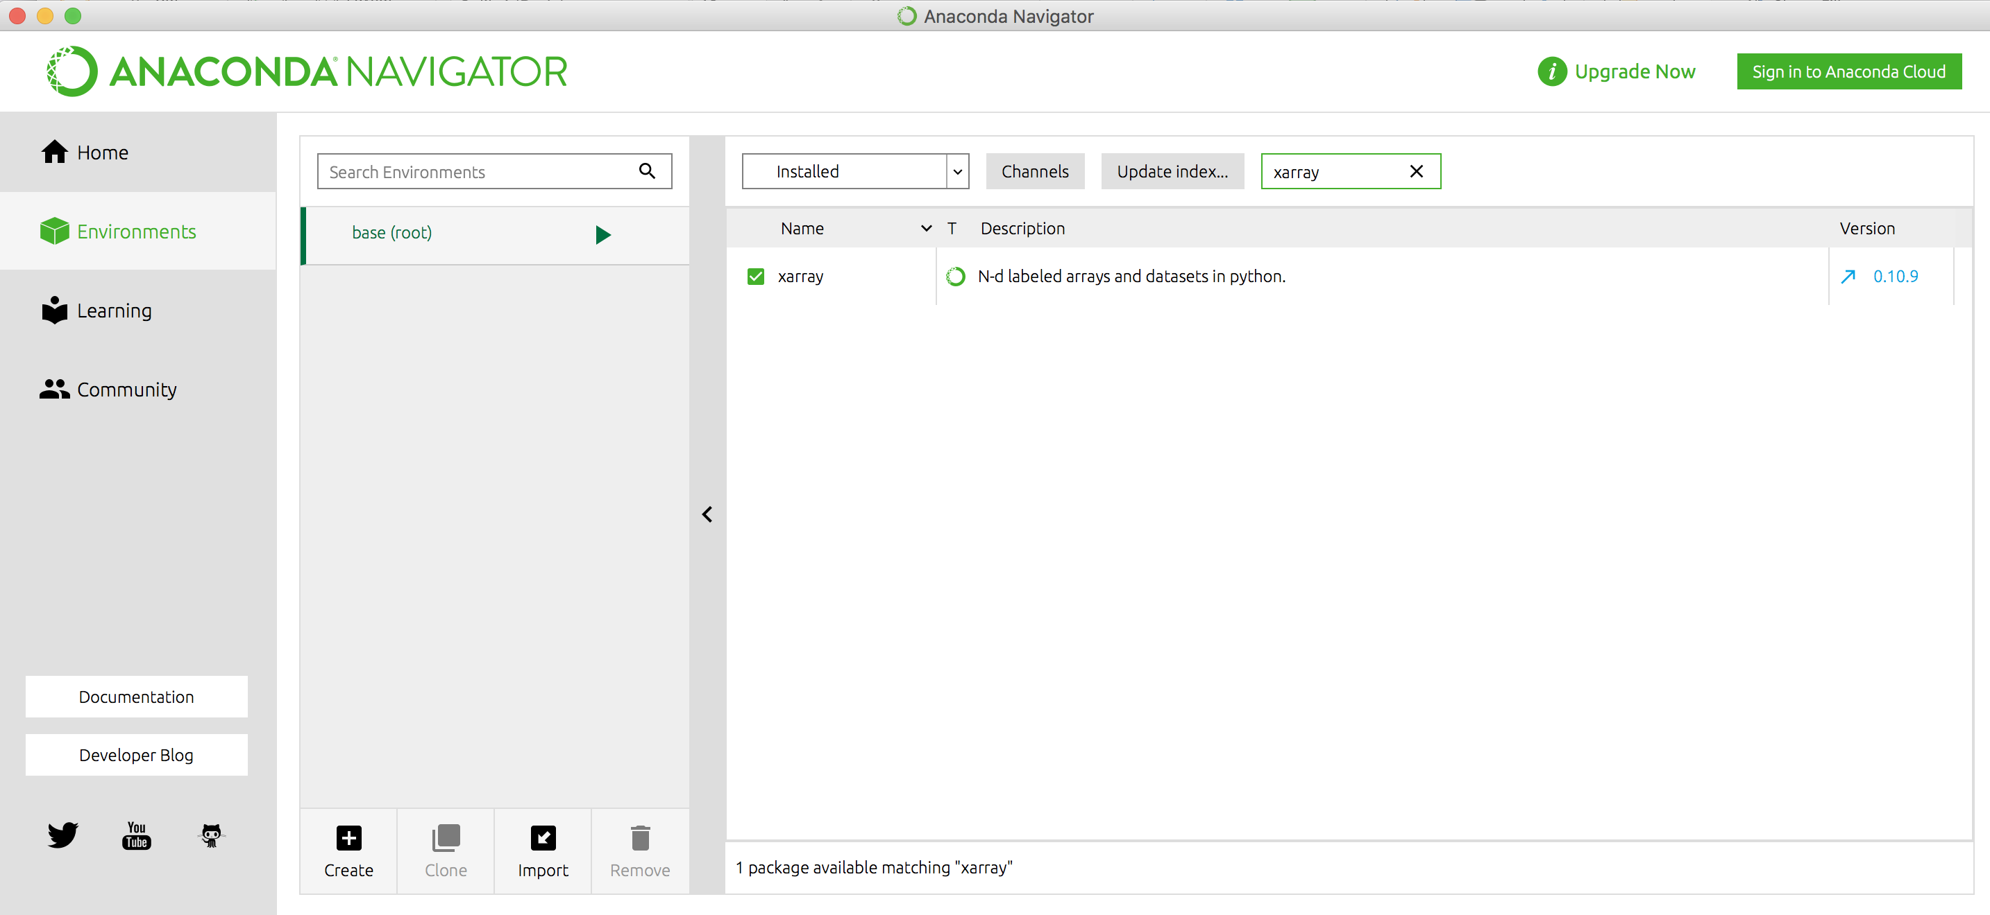
PRACTICAL #3
Before starting, make sure you have:
Python installed (install the Anaconda distribution via https://www.anaconda.com/download/ )
The following packages installed: xarray, cartopy
pip freeze
In a terminal, type “ ” to list the python packages you have installed; or use Anaconda-nagivator:
Otherwise install those packages.
conda install -c anaconda cartopy
conda install -c anaconda xarray
pip install cmocean

Slide 3
PRACTICAL #3
For this practical, we will be using the JUPYTER interface.
Jupyter is an interactive programming environment. It runs from your local computer (in the terminal/cmd), and uses the browser as an interface. Note that it does not run online!
Jupyter can be launched using the using **Anaconda Navigator** or from the **terminal** (MacOS and Linux) with the `jupyter-notebook` command. Your browser should launch automatically.
Jupyter consists of *cells* or blocks of code that can be run independently. These are run by pressing
`CTRL + Enter` (stay on cell) or `SHIFT + Enter` (go to next cell)
The help function in jupyter: You can run a function followed by a `?` for documentation and `??` for documentation + code. Then hold `SHIFT` while pressing `TAB` up to four times to show different displays of the documentation.
Content taken from Luke Gregor “Python for oceanographers” course

Slide 4
PRACTICAL #3
Task
Open the “Practical#3” notebook and proceed the data analysis of GLODAP v1 and v2 products.
Note that the products have been pre-processed and merged for the purpose of this practical.

